Slide 1
Kaggle Dataset
Predicting House Prices with Machine Learning
https://www.kaggle.com/code/erick5/predicting-house-prices-with-machine-learning

Slide 2
Load Data and Packages
Analyzing the Test Variable (Sale Price)
Multivariable Analysis
Impute Missing Data and Clean Data
Feature Transformation/Engineering
Modeling and Predictions

Slide 3

Loading Data and Packages
From looking at the head of both sets (train and test), we can see that the only difference in features is "Sale Price". This makes sense because we are trying to predict it!

Slide 4
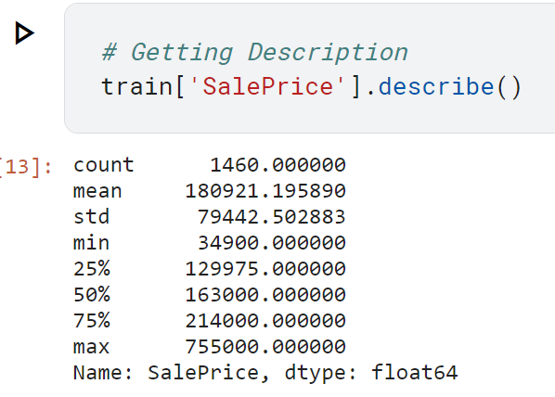
Analyzing the Test Variable
Let's check out the most interesting feature in this study: Sale Price
mean = 180,921.20 and
sigma = 79,415.29

Slide 5

If you have a dataset with a mean income of $180,921.20 and a standard deviation of $79,415.29, you might observe that most individual incomes in the dataset fall within one standard deviation of the mean (around $101,505.91 to $260,336.49), based on the typical characteristics of a normal distribution.
This information is valuable for understanding the variability in the dataset and making statistical inferences.

Slide 6

Skewness: 1.882876
Kurtosis: 6.536282
Positive skewness (1.882876) suggests a distribution skewed to the right.
Positive kurtosis (6.536282) indicates heavier tails and more outliers compared to a normal distribution.
Should we fix this?

Slide 7
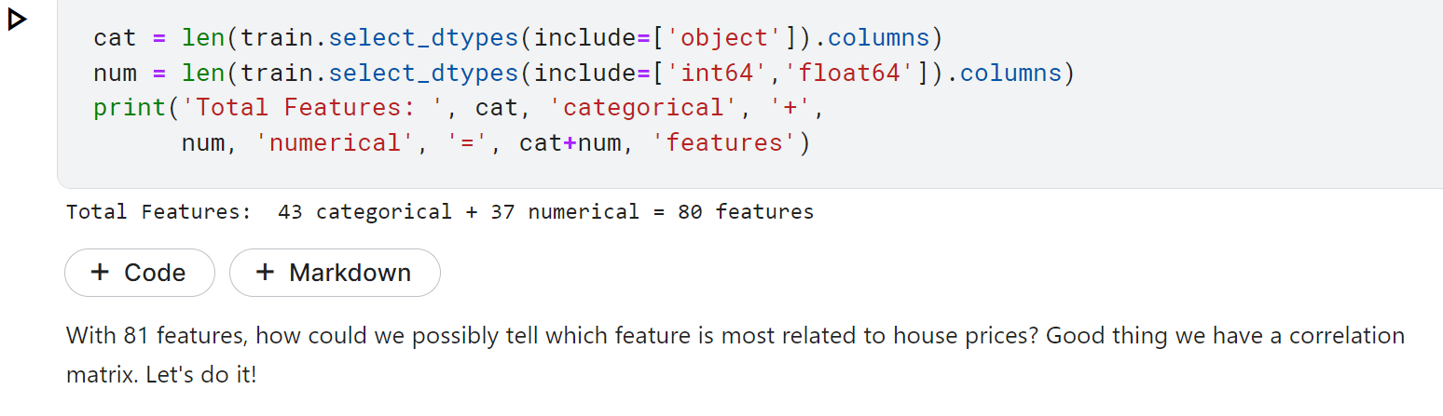
Multivariable Analysis

Slide 8
Let's zoom into the top 9 features most related to Sale Price
OverallQual: Rates the overall material and finish of the house (1 = Very Poor, 10 = Very Excellent)
GrLivArea: Above grade (ground) living area square feet
GarageCars: Size of garage in car capacity
GarageArea: Size of garage in square feet
TotalBsmtSF: Total square feet of basement area
1stFlrSF: First Floor square feet
FullBath: Full bathrooms above grade
TotRmsAbvGrd: Total rooms above grade (does not include bathrooms)
YearBuilt: Original construction date

Slide 9
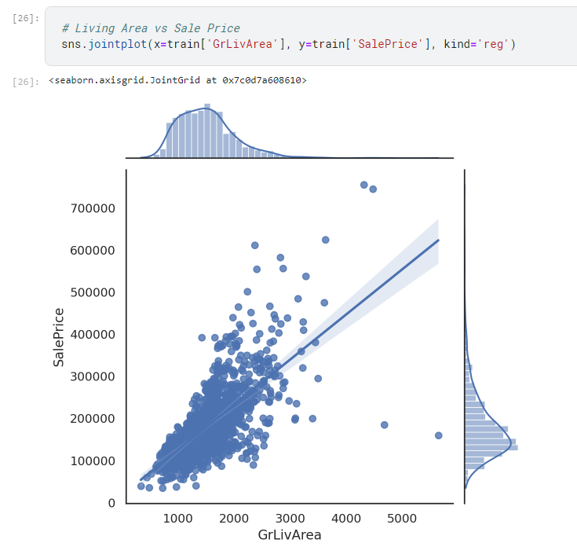
Living areas versus sales price shows us that there are 2 outliers on the bottom right
We would like to drop these two data points from the dataset so that we have a cleaner dataset
# Removing outliers manually (Two points in the bottom right)
train = train.drop
(train[(train['GrLivArea’]>4,000)
& (train['SalePrice']<300,000)].index).
reset_index(drop=True)

Slide 10
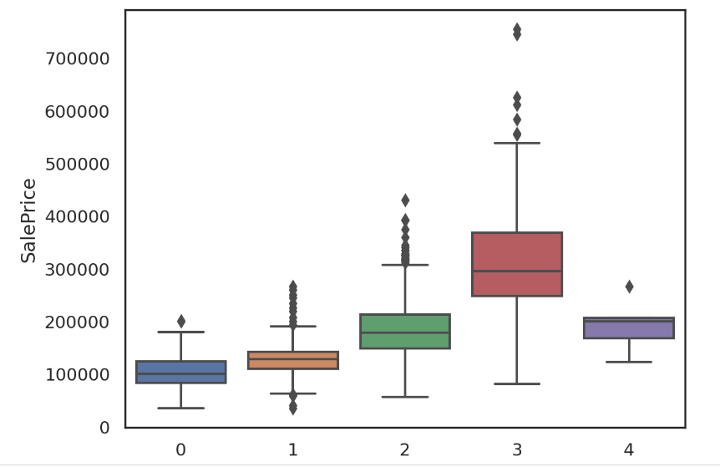
GarageCars: Similarly other outliers were removed from columns that are of interest
4-car garages result in less Sale Price? That doesn't make much sense. Let's remove those outliers.
Note: removal of data is totally discretionary and may or may not help in modeling. Use at your own preference.

Slide 11
Impute Missing Data and Clean Data
Important questions when thinking about missing data:
How prevalent is the missing data?
Is missing data random or does it have a pattern?
The answer to these questions is important for practical reasons because missing data can imply a reduction of the sample size. This can prevent us from proceeding with the analysis. Moreover, from a substantive perspective, we need to ensure that the missing data process is not biased and hiding an inconvenient truth.
Let's combine both training and test data into one dataset to impute missing values and do some cleaning.

Slide 12
Feature Transformation/Engineering
Let's take a look at some features that may be misinterpreted to represent something it's not.
MSSubClass: Identifies the type of dwelling involved in the sale.
20 1-STORY 1946 & NEWER ALL STYLES
30 1-STORY 1945 & OLDER
40 1-STORY W/FINISHED ATTIC ALL AGES

Slide 13
Feature Transformation/Engineering (continued)
45 1-1/2 STORY - UNFINISHED ALL AGES
50 1-1/2 STORY FINISHED ALL AGES
So, the average is a 57 type. What does that mean? Is a 90 type 3 times better than a 30 type? This feature was interpreted as numerical when it is actually categorical. The types listed here are codes, not values. Thus, we need to feature transformation with this and many other features.
Make it a string (categorical)

Slide 14
Fixing "skewed" featuresHere, we fix all of the skewed data to be more normal so that our models will be more accurate when making predictions.
# We use the numpy fuction log1p which applies log(1+x) to all elements of the column
train["SalePrice"] = np.log1p(train["SalePrice"])
Homework: Play around with np.log1p and see how it changes the data!!

Slide 15
6. Modeling and Predictions
score = rmsle_cv(lasso)
print("\nLasso score: {:.4f} ({:.4f})\n".format(score.mean(), score.std()))
score = rmsle_cv(ENet)
print("ElasticNet score: {:.4f} ({:.4f})\n".format(score.mean(), score.std()))
score = rmsle_cv(KRR)
print("Kernel Ridge score: {:.4f} ({:.4f})\n".format(score.mean(), score.std()))
score = rmsle_cv(GBoost)
print("Gradient Boosting score: {:.4f} ({:.4f})\n".format(score.mean(), score.std()))
score = rmsle_cv(model_xgb)
print("Xgboost score: {:.4f} ({:.4f})\n".format(score.mean(), score.std()))
score = rmsle_cv(model_lgb)
print("LGBM score: {:.4f} ({:.4f})\n" .format(score.mean(), score.std()))

Slide 16
Here, we stack the models to average their scores.
class AveragingModels(BaseEstimator, RegressorMixin, TransformerMixin):
def __init__(self, models):
self.models = models
# we define clones of the original models to fit the data in
def fit(self, X, y):
self.models_ = [clone(x) for x in self.models]
# Train cloned base models
for model in self.models_:
model.fit(X, y)
return self
#Now we do the predictions for cloned models and average them
def predict(self, X):
predictions = np.column_stack([
model.predict(X) for model in self.models_
])
return np.mean(predictions, axis=1)

Slide 17
Ensemble Prediction
Note: To get our weights for each model, we'll take the inverse of each regressor and average it out of 100%

Slide 18
References
Bias and variance (6.5 min video)
https://www.youtube.com/watch?v=EuBBz3bI-aA

Slide 19
Next steps
Pick an ongoing competition at Kaggle which still has about 30 days left
1
Discuss with us
2
Build a team to work on our free time
3
Submit to Kaggle!
4

